Slide 1
JAVASCRIPT
Functions & FUNCTION HOISTING

Slide 2
JavaScript Functions
A function is a block of code that executes tasks in a specific order
function functionName (parameters) {
// Do stuff here
}
function is a keyword that tells JavaScript you’re defining a function.
functionName is the name of the function.
parameters is a comma-separated list of variables you wish to declare for your function. They can be assigned values when you use the function. Parameters are optional.
If you declared a parameter, but did not pass a argument to it, your parameter would be undefined .
Rules for naming functions
It must be one word
It must consist only of letters & numbers or underscores
It cannot begin with a number
It cannot be any of the reserved keywords

Slide 3
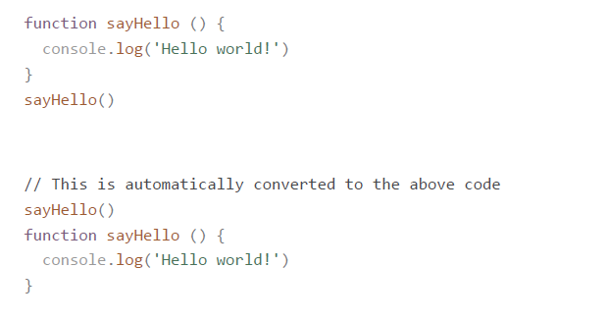
Function hoisting
When functions are declared with a function declaration (as shown above), they are hoisted to the top of your scope.
This means the following two sets of code are exactly the same.
Function hoisting gets confusing because JavaScript changes the order of code. It is
highly recommended that you declare your functions before you use them. Don’t rely on
hoisting.

Slide 4
Declaring functions with function expressions
A second way to declare functions is with a function expression. Here, you declare a
variable, then assign a function without a name (an anonymous function) to it.
const sayHello = function () {
console.log('This is declared with a function expression!’)
}
Note: Functions declared with function expressions are not automatically hoisted to the top of your scope.

